Slide 1
AR & MA Processes

Slide 2
Basic time series nomenclature
Process: That which generates a series of observations
Model: A mathematical representation that describes a process
In general, a series consists of:
Trend
Linear
Polynomial
Logarithmic
Seasonality
Cyclical over time (hourly, daily, weekly, monthly, yearly, …)
Stochastic process
Some of it model-able
The rest of it, white noise
We generally want to model these effects separately

Slide 3
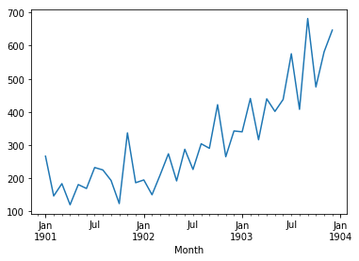
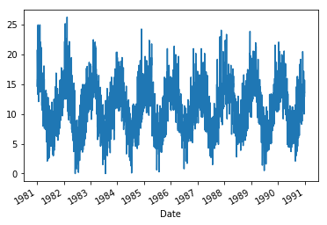
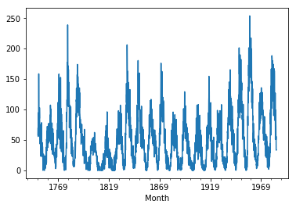
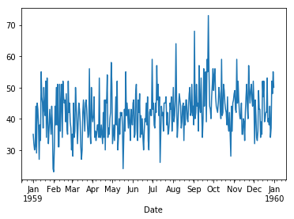
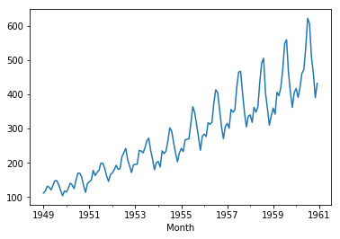
Data sets used in Brownlee’s book
Examples of time series exhibiting various amounts of trend, seasonality, and noise
 | Shampoo Sales | Minimum Daily Temperatures | Monthly Sunspots | Daily Female Births | Airline Passengers
Observations | 36 | 3650 | 2820 | 365 | 144
Trend | X |  |  |  | X
Seasonality |  | X | X |  | X
Monthly number of shampoo sales over a 3 year period (year 1-3)
Minimum daily temperatures over 10 years (1981-1990) in Melbourne, Australia
Monthly number of observed sunspots over 235 years (1749-1983)
Number of daily female births in California in 1959
Monthly number of airline passengers (in thousands) over 12 years (1949-1960)

Slide 4
General time series breakdown
Time series
Seasonality
Trend
Stationary stochastic process
Autoregressive AR(p) and/or
Moving Average MA(q) process
iid noise

Slide 5
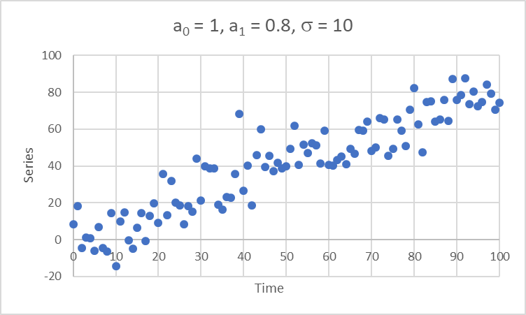
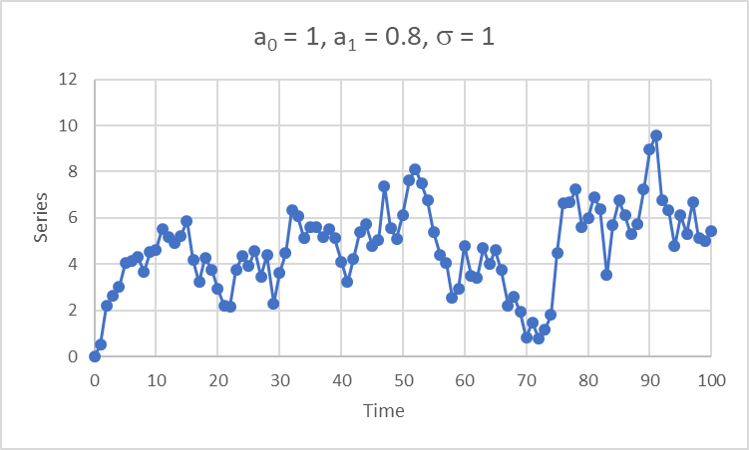
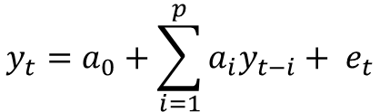
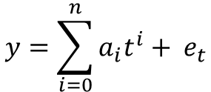
OLS Regression vs. Auto-Regression
Polynomial regression model
Autoregressive (AR) model
$$y=\sum_{i=0}^{n}{a_{i}t^{i}+ e_{t}}$$
$$y_{t}=a_{0}+\sum_{i=1}^{p}{a_{i}y_{t−i}+ e_{t}}$$
y = a₀ + a₁t + a₂t² + a₃t³ + … + e_{t}
y_{t} = a₀ + a₁y_{t-1} + a₂y_{t-2} + a₃y_{t-3} + … + e_{t}
y is a function of the independent variable t (plus a random error term)
y is dependent on its own past data points (plus a random error term)
1st order polynomial model: y = a₀ + a₁t + e_{t}
AR(1) model: y_{t} = a₀ + a₁y_{t-1} + e_{t}

Slide 6
OLS Regression vs. Auto-Regression
But when it comes to fitting a model to a data set, the name of the game is the same:
Extract the underpinning model from the data series (the equation that describes the dynamics of the data series), leaving only white noise as the residual.
Do not overfit the data (use more terms/coefficients than necessary to describe the model).

Slide 7
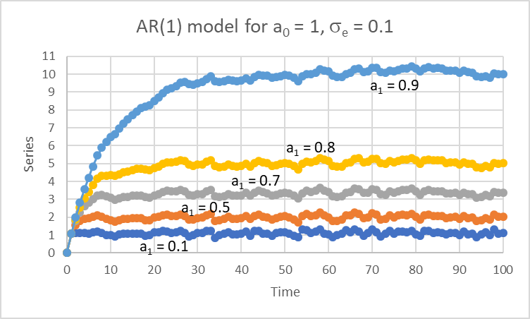
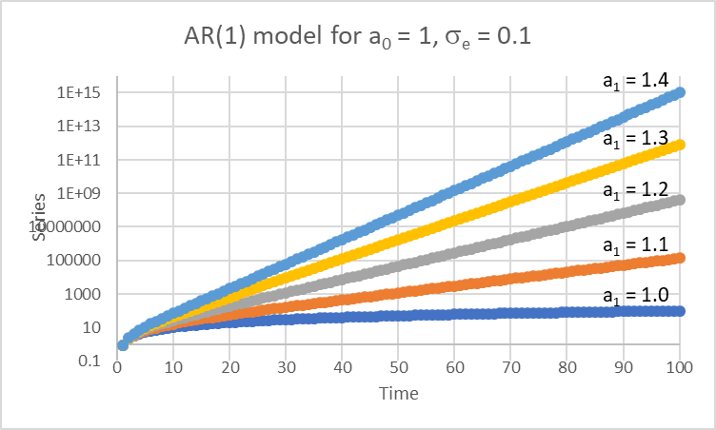

AR(1) model properties
AR(1) model: y_{t} = a₀ + a₁y_{t-1} + e_{t}
If |a₁| < 1 → the series converges → the process is “stationary”
If |a₁| ≥ 1 → the series diverges → the process is “non-stationary” or “explosive”
If |a₁| < 1, series converges to:
$$E\left(y_{t}\right)= \frac{a_{0}}{1−a_{1}}$$
Note log scale!

Slide 8
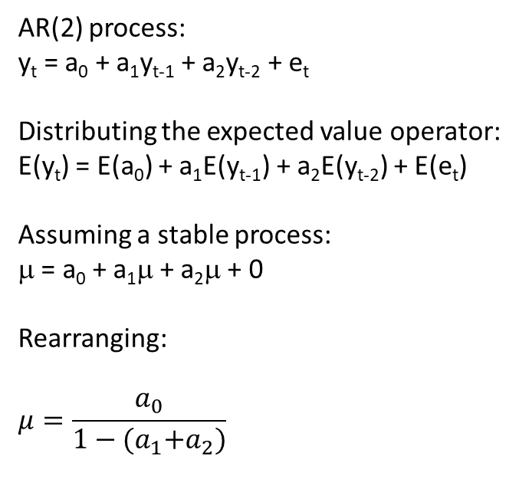
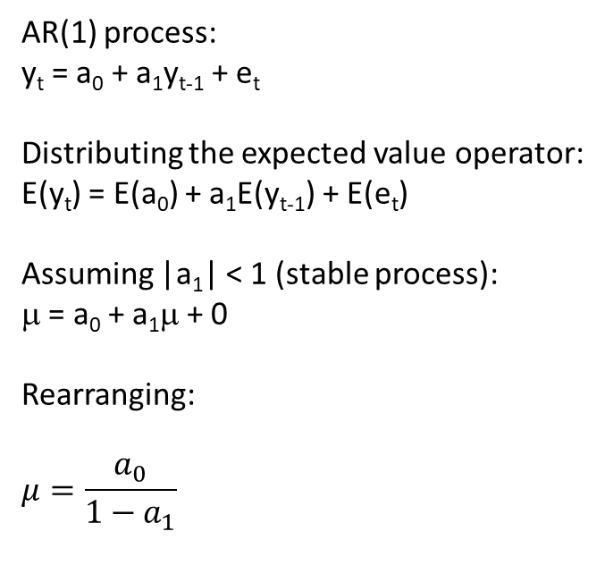

Convergence of stationary AR(p) processes
AR(1) process:
y_{t} = a₀ + a₁y_{t-1} + e_{t}
Distributing the expected value operator:
E(y_{t}) = E(a₀) + a₁E(y_{t-1}) + E(e_{t})
Assuming |a₁| < 1 (stable process):
μ = a₀ + a₁μ + 0
Rearranging:
$$μ=\frac{a_{0}}{1−a_{1}}$$
AR(2) process:
y_{t} = a₀ + a₁y_{t-1} + a₂y_{t-2} + e_{t}
Distributing the expected value operator:
E(y_{t}) = E(a₀) + a₁E(y_{t-1}) + a₂E(y_{t-2}) + E(e_{t})
Assuming a stable process:
μ = a₀ + a₁μ + a₂μ + 0
Rearranging:
$$μ=\frac{a_{0}}{1−{(a}_{1}+a_{2})}$$
AR(p) process:
$$μ=\frac{a_{0}}{1−\left(\sum_{i=1}^{p}{a_{i}}\right)}$$

Slide 9
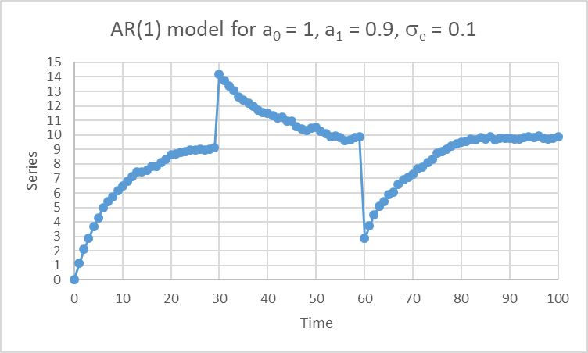
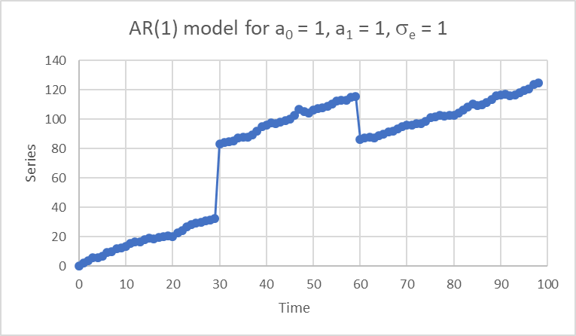
Responses to exogenous shocks
Stationary AR(1) model
Recovers regardless of exogenous shocks
Non-stationary AR(1) model
Trend is reset with each exogenous shock
+5
-30
-7
+50

Slide 10
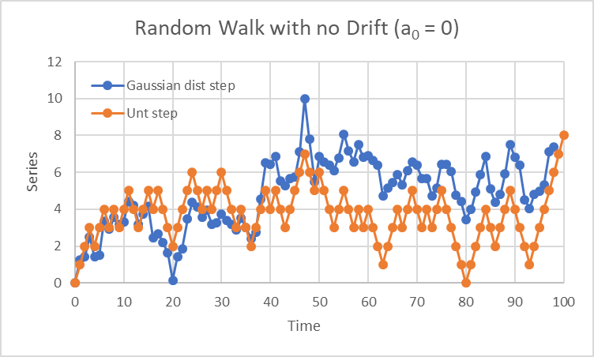
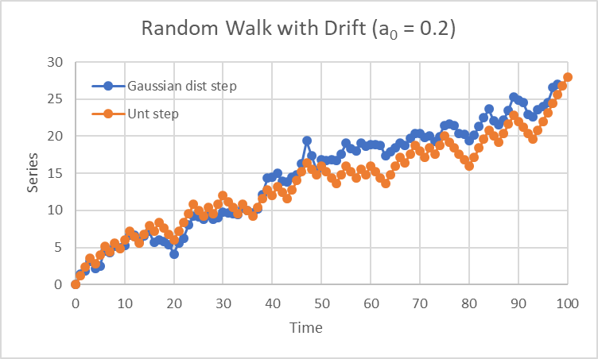
AR(1) process example: The Random Walk
y_{t} = a₀ + a₁y_{t-1} + e_{t}
a₀ = drift term
a₁ = 1
e_{t} = random “step”
(can be gaussian distribution or random unit steps, i.e. -1, 1)

Slide 11
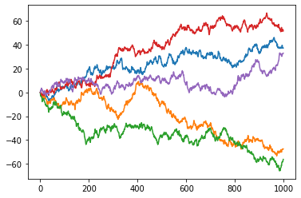
AR(1) process example: The Random Walk
y_{t} = a₀ + a₁y_{t-1} + e_{t}
a₀ = 0
a₁ = 1
σ_{e} = 1
The random walk can result in positive or negative values

Slide 12
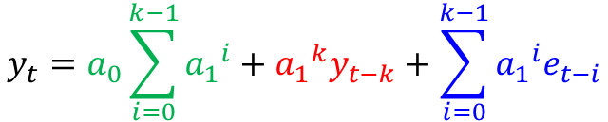


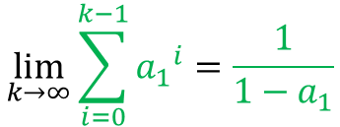

Dependence on past values
AR(1) process:
$$y_{t}=a_{0}+a_{1}y_{t−1}+e_{t}$$
(eqn 1)
Backdating:
$$y_{t−1}=a_{0}+a_{1}y_{t−2}+e_{t−1}$$
(eqn 2)
Backdating again:
$$y_{t−2}=a_{0}+a_{1}y_{t−3}+e_{t−2}$$
(eqn 3)
Substituting eqn 2 into eqn 1:
$$y_{t}=a_{0}+a_{1}\left(a_{0}+a_{1}y_{t−2}+e_{t−1}\right)+e_{t}$$
$$=a_{0}+a_{1}a_{0}+{a_{1}}^{2}y_{t−2}+{a_{1}e}_{t−1}+e_{t}$$
(eqn 4)
Substituting eqn 3 into eqn 4:
$$y_{t}=a_{0}+a_{1}a_{0}+{a_{1}}^{2}\left(a_{0}+a_{1}y_{t−3}+e_{t−2}\right)+{a_{1}e}_{t−1}+e_{t}$$
$$=a_{0}+a_{1}a_{0}+{a_{1}}^{2}a_{0}+{a_{1}}^{3}y_{t−3}+{a_{1}}^{2}e_{t−2}+{a_{1}e}_{t−1}+e_{t}$$
$$y_{t}=a_{0}\sum_{i=0}^{k−1}{{a_{1}}^{i}}+{a_{1}}^{k}y_{t−k}+\sum_{i=0}^{k−1}{{{a_{1}}^{i}e}_{t−i}}$$
Where k = number of lags
$$\lim_{k→∞}{\sum_{i=0}^{k−1}{{a_{1}}^{i}=\frac{1}{1−a_{1}}}}$$
Note the Taylor Series:
for |a₁| < 1

Slide 13
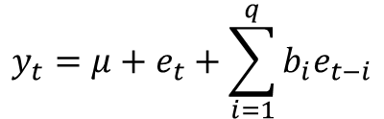
Moving Average (MA) model
Moving Average (MA) model
$$y_{t}=μ+e_{t}+\sum_{i=1}^{q}{b_{i}e_{t−i}}$$
Brownlee, p. 200:
An autoregression of the residual error time series is called a Moving Average (MA) model.
This is confusing because it has nothing to do with the moving average smoothing process.
Think of it as the sibling to the autoregressive (AR) process, except on lagged residual error rather than lagged raw observations.
y_{t} = μ + e_{t} + b₁e_{t-1} + b₂e_{t-2} + b_{q}e_{t-q}
y is dependent on current and past error values (plus the series mean)
MA(1) model: y_{t} = μ + e_{t} + b₁e_{t-1}

Slide 14
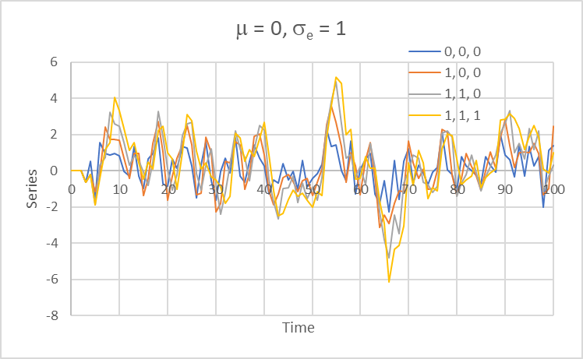
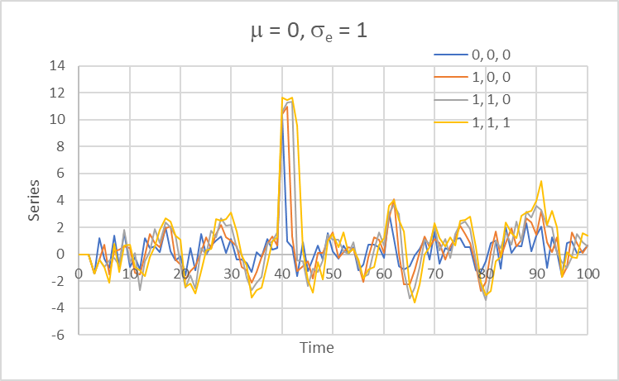
Moving Average (MA) model
y_{t} = μ + e_{t} + b₁e_{t-1} + b₂e_{t-2} + b_{q}e_{t-q}
b₁, b₂, b₃
Turning on higher order q terms tends to drag out, and increase, the effect of the immediate error.
However, the effect of an exogenous shock does not persist as it does in the AR model.

Slide 15
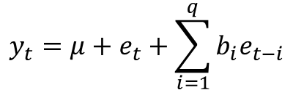
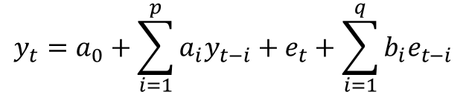
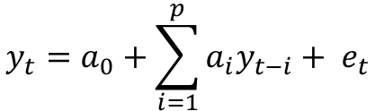
ARMA model
$$y_{t}=a_{0}+\sum_{i=1}^{p}{a_{i}y_{t−i}+ e_{t}}$$
AR(p) model:
$$y_{t}=μ+e_{t}+\sum_{i=1}^{q}{b_{i}e_{t−i}}$$
MA(q) model:
$$y_{t}=a_{0}+\sum_{i=1}^{p}{a_{i}y_{t−i}}+e_{t}+\sum_{i=1}^{q}{b_{i}e_{t−i}}$$
ARMA(p,q) model:

Slide 16
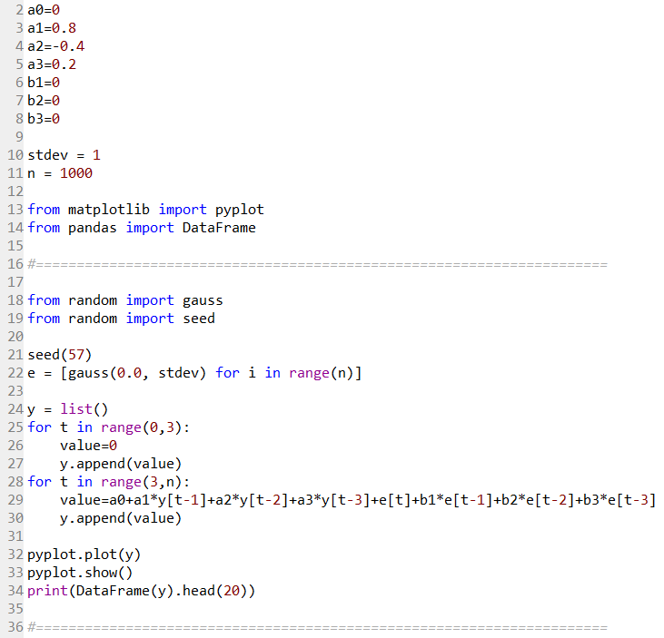
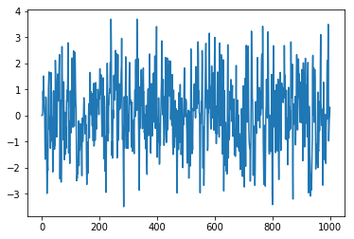
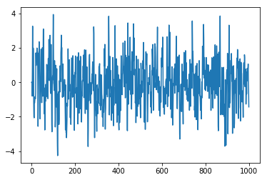
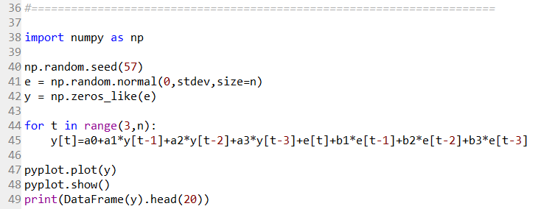
Methods by which to simulate an ARMA series
0 0.000000
1 0.000000
2 0.000000
3 0.145425
4 0.935497
5 0.569157
6 1.513351
7 0.940826
8 0.409831
9 0.121435
10 0.012752
11 -1.157428
12 -1.679176
13 -1.471900
14 0.706878
15 0.608007
16 -0.322488
17 -1.858313
18 -2.991274
19 -2.240464
White noise generator first introduced in Brownlee Ch. 10.4
x = list() and x.append(value) first introduced in Brownlee Ch. 9.6
0 0.000000
1 0.000000
2 0.000000
3 -0.794418
4 0.892467
5 3.268146
6 -0.512865
7 -0.773048
8 1.986505
9 0.106711
10 -1.130031
11 -1.998328
12 -2.063573
13 -1.153034
14 -1.198421
15 -1.070876
16 -0.834856
17 -0.911171
18 -0.948963
19 -0.611806
Alternate method

Slide 17
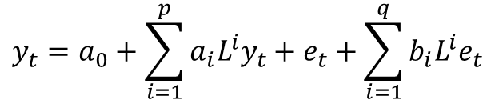
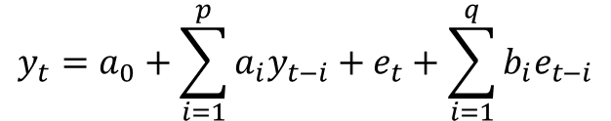



Lag Operator Notation
$${Ly}_{t}=y_{t−1}$$
$${L^{2}y}_{t}=y_{t−2}$$
The lag operator (L) is sometimes expressed as the “backshift” operator (B)
$$L^{n}y_{t}=y_{t−n}$$
$$y_{t}=a_{0}+\sum_{i=1}^{p}{a_{i}y_{t−i}}+e_{t}+\sum_{i=1}^{q}{b_{i}e_{t−i}}$$
For example:
ARMA(p,q) model:
$$y_{t}=a_{0}+\sum_{i=1}^{p}{a_{i}{L^{i}y}_{t}}+e_{t}+\sum_{i=1}^{q}{b_{i}{L^{i}e}_{t}}$$

Slide 18
Lag Operator Notation
(1 – L²)y_{t} = y_{t} – y_{t-2}
Be careful, note the difference!
(1 – L)²y_{t} =
(1 – L)(1 – L)y_{t}
(1 – L)(y_{t} – y_{t-1})
(y_{t} – y_{t-1}) – (y_{t-1} – y_{t-2})
y_{t} – 2y_{t-1} + y_{t-2}

Slide 19
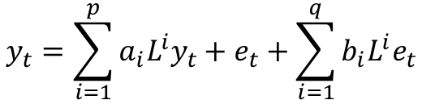
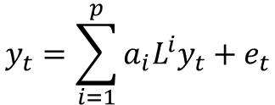

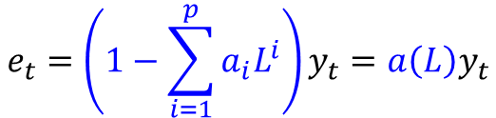
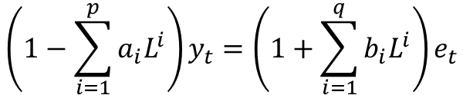
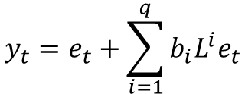

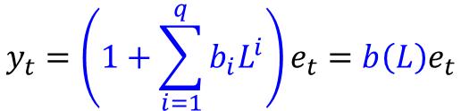

Lag Operator Notation
$$y_{t}=\sum_{i=1}^{p}{a_{i}{L^{i}y}_{t}}+e_{t}$$
$$e_{t}=\left(1−\sum_{i=1}^{p}{a_{i}L^{i}}\right)y_{t}=a\left(L\right)y_{t}$$
AR(p):
$$y_{t}=e_{t}+\sum_{i=1}^{q}{b_{i}{L^{i}e}_{t}}$$
$$y_{t}=\left(1+\sum_{i=1}^{q}{b_{i}L^{i}}\right)e_{t}=b\left(L\right)e_{t}$$
MA(q):
$$y_{t}=\sum_{i=1}^{p}{a_{i}{L^{i}y}_{t}}+e_{t}+\sum_{i=1}^{q}{b_{i}{L^{i}e}_{t}}$$
$$\left(1−\sum_{i=1}^{p}{a_{i}L^{i}}\right)y_{t}=\left(1+\sum_{i=1}^{q}{b_{i}L^{i}}\right)e_{t}$$
ARMA(p,q):
$$a\left(L\right)y_{t}=b\left(L\right)e_{t}$$
$$y_{t}=\frac{b\left(L\right)}{a\left(L\right)}e_{t}$$
or
$$\frac{a\left(L\right)}{b\left(L\right)}y_{t}=e_{t}$$

